Slide 1
THE VELUX STIFTUNG RETINOBLASTOMA MOLECULAR RESEARCH PROJECT
Dr. Lucy Njambi: PI
Dr. Helen Dimaras: Co-PI
14.05.2024

Slide 2
Objectives
Highlight ground work for setting up RB genetic services in Kenya
Overview of the Velux Stiftung RB genetics project
Vision
Goals
Components
Role of collaborators and stakeholders

Slide 3
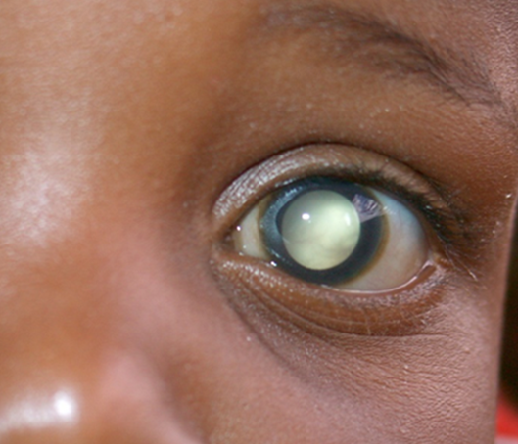
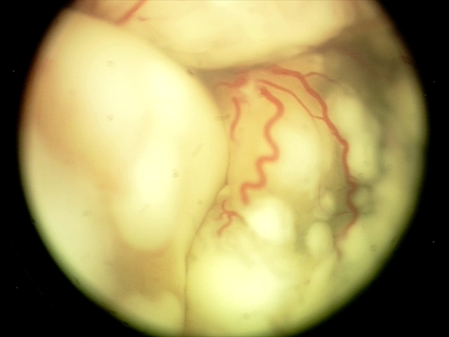
Introduction on Retinoblastoma
Commonest intraocular malignancy in children
Arises from the retina
Incidence worldwide 1:17,000
No sex, race preponderance
Commonly presents in children below 5 years
It can affect one eye (60%) or both eyes (40%)
Family history in 10% of the children
In Kenya, it contributes 5 % cancers 10% blindness
Survival 26%(2008); 69% (2019)

Slide 4
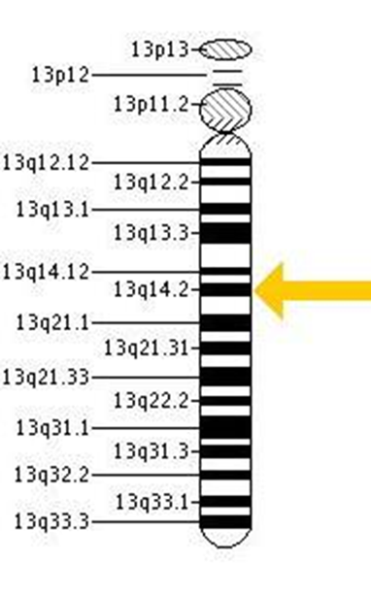
Introduction on Retinoblastoma
First tumour described to have genetic origin
Mutation of RB1 gene, tumour suppressor gene
All bilateral and familial cases are heritable
Need for serial examination under anaesthesia
Genetic testing recommended for the standard care
Genetic services remain scarce and limited in the LMICs

Slide 5
Benefits of Genetic testing
Improves outcomes and reduces early mortality
Allows focused follow up of family members at risk
Reduces unnecessary examinations under anaesthesia
Allows informed reproductive choices and reduces psychological stress
Cost effective in the long- run
Reduces hospital systems / clinicians, social and overall economic burden

Slide 6
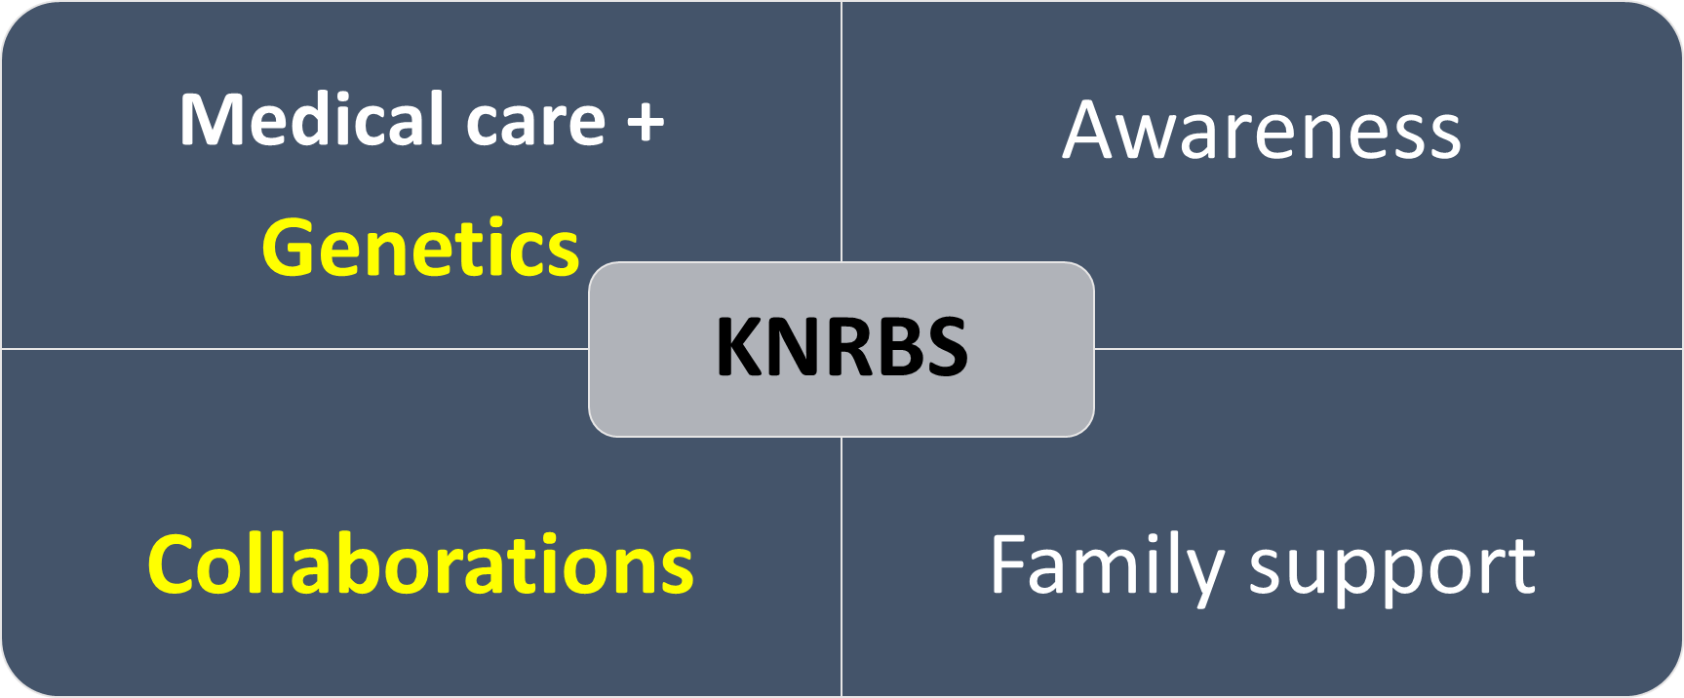
The Kenya National retinoblastoma strategy (2008)

Slide 7
Background work
Prior research
Identifying the gaps in genetic services

Slide 8
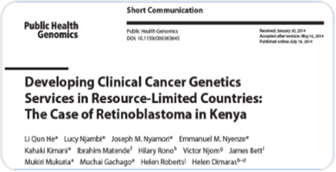
Situation analysis research - 2013
Challenges to implementation of genetic services identified by clinicians
Clinicians perspective
Patients perspective
Suggested model focusing on:
Medical Education
Patient & Family Counselling
Community Involvement

Slide 9
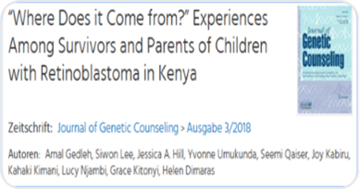
Knowledge gap of retinoblastoma origin / genetics - 2017
Origin of retinoblastoma unclear
Expressed need for genetic services
Families often confused about complex genetic consents and need counselling
Developed pilot counselling booklet

Slide 10
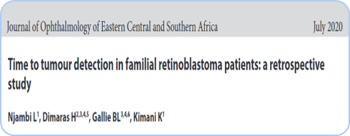
Comparative study in time to tumour detection in familial RB at KNH and SickKids – 2020
Delayed diagnosis and poor outcome without genetic testing
Mean time 3.8 Vs 25 months
Better Vision- SickKids
Enucleation: 5 Vs 100%
KNH: 17% extraocular

Slide 11
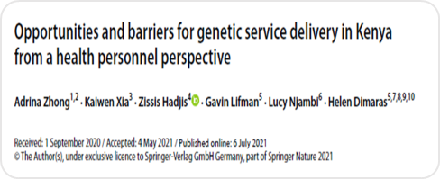
Opportunities and barriers for genetic service delivery in Kenya - 2021
Opportunities: Demand, Education & Training, Lab infrastructure, Collaboration
Challenges: Education & Training, Costs, Counselling

Slide 12



BUILDING CAPACITY IN MOLECULAR CANCER RESEARCH IN KENYA THROUGH ANALYSIS OF RETINOBLASTOMA HETEROGENEITY

Slide 13
Velux Stiftung Grant 2022
Ophthalmology research grant in low- and middle-income countries
High impact research to foster change
Interdisciplinary biomedical research projects in ophthalmology
Aim to develop and assess new diagnostic, prevention, or treatment methods for eye diseases adapted to the local context and environment of LMICs

Slide 14
Ophthalmology
Genetic testing in RB (NGS)
Pathology
Lab infrastructure
KAVI-ICR
CEBIB
Biomedical research
SickKids
Global child
Health
Training
Support
Capacity building

Slide 15
Conclusion
Genetic services
Clinicians & Caregivers
Education
Genetic testing
Genetic counselling

Slide 16
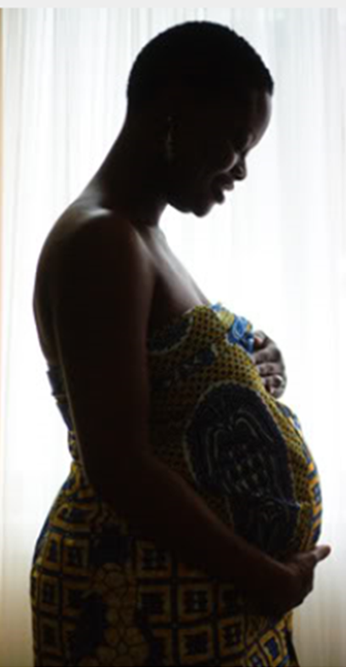
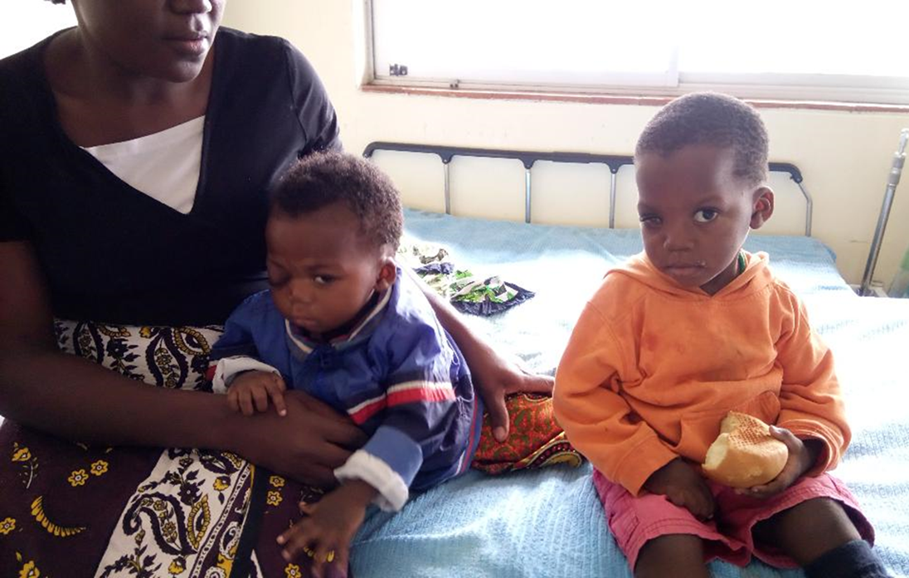
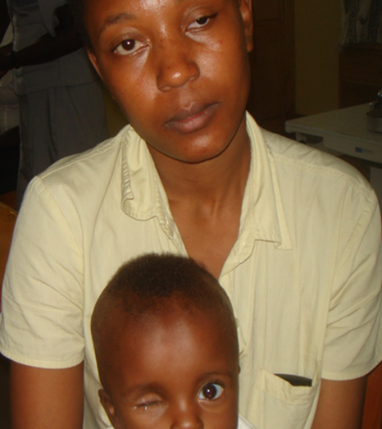
Break the cycle: Foster change in RB care in Kenya

Slide 17



